Slide 1


Smart Devices & services
By
Dr. nilesh m. patil

Slide 2

Definition
A smart device is an electronic device, generally connected to other devices or networks via different protocols such as Bluetooth, NFC, wi-fi, 3G/4g/5g, etc., That can operate to some extent interactively and autonomously

Slide 3
What makes a device smart?
Connectivity
To the internet
Wireless
This means they don’t need wires to connect to other devices (except when charging)
To other devices
Can be carried around easily
Portable

Slide 4
What makes a device smart?
Data processing
Capable of storing and manipulating data.
Autonomous (to a certain degree)
They can carry out tasks according to the way they are programmed so the user doesn’t always need to make command inputs

Slide 5
Examples of smart devices
Smartphones
Tab
Smart watches
Smart wristbands
Smart glasses

Slide 6
Smartphones

Slide 7
Differences between smartphones and regular cell phones
Regular cellphones can only make calls and exchange texts
Smartphones are like mini computers which can handle a large variations of tasks ranging from accessing the internet to controlling a computer remotely.

Slide 8
General Properties of a smartphone
Can be used to place calls or exchange SMS and MMS
Access the internet
Can take pictures and record videos
Capable of video chat

Slide 9
Specific Properties of a smartphone
Store and edit data
Able to connect to other devices via cable, Bluetooth, Wi-Fi, NFC, etc.
Supports the installation of various programs

Slide 10
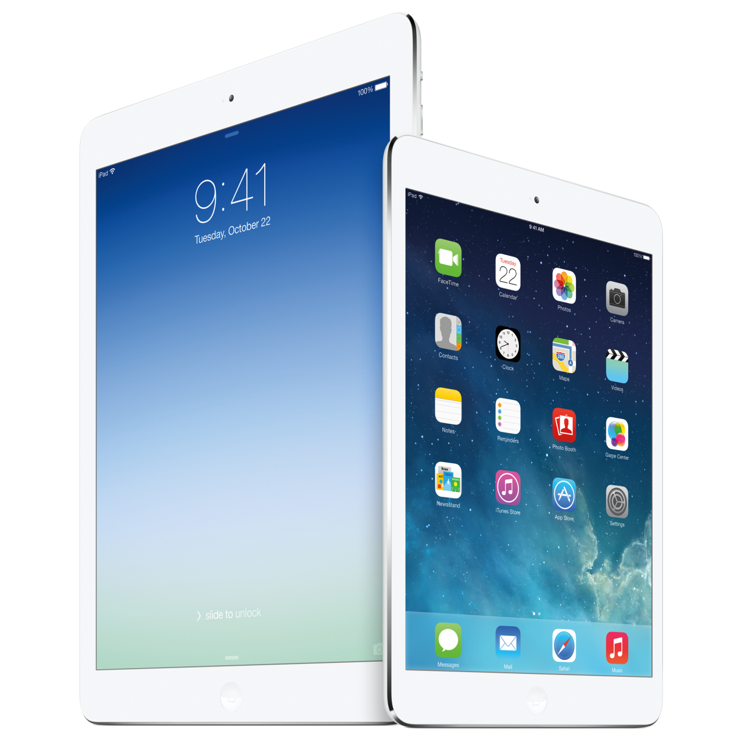
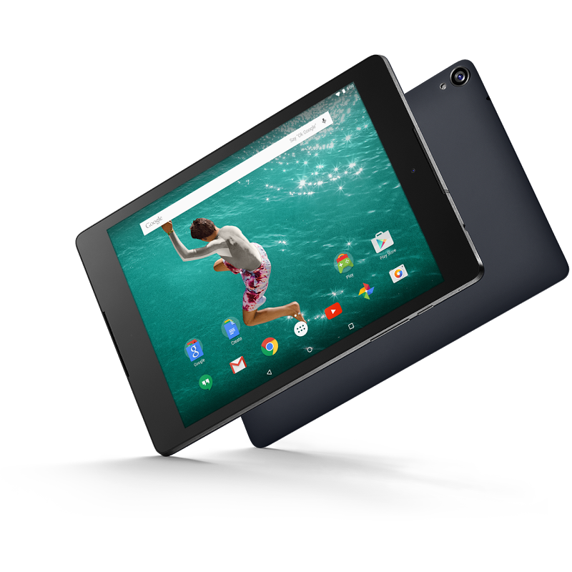
tablet pc

Slide 11
tablet pc
Tablets are a lot like smartphones. So instead of listing the similarities, let us look at their differences
Larger screen (between 7 inches to 11 inches)
Higher processing power
Tablets are less portable due compared to smartphones
Some tablets don’t support any SIM
Some tablets have USB ports and some even have HDMI ports.

Slide 12
Wearable devices
Wearable devices are, as the name implies, smart devices which can be worn by a person
Smart Watch
Smart Glass
Smart Band

Slide 13
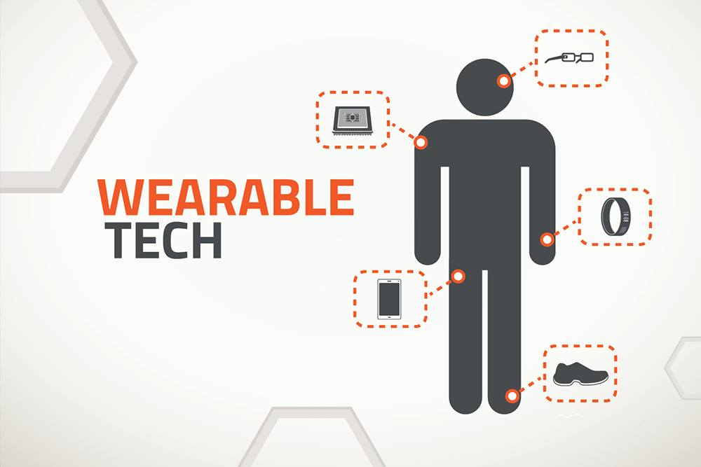

Slide 14
Types of Wearable devices
Watches
Glasses
Bracelets or wristbands
And more

Slide 15
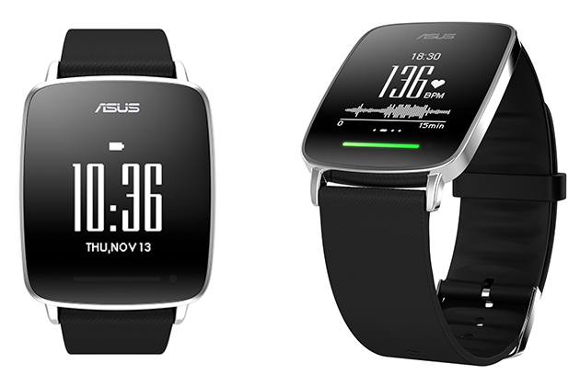
Smart watches

Slide 16
Smart watches
A wearable computing device worn on a user's wrist that offers functionality and capabilities similar to those of a smartphone. Smart watches are designed to, either on their own or when paired with a smartphone, provide features like:
Connecting to the internet
Shows notifications on the watch while connected to a smartphone
Runs mobile apps
It can obviously tell time and has a huge choice of displays
Some provide fitness monitoring capabilities
Can be used to give various commands to a connected smartphone

Slide 17
Smart glasses
Smart glasses are a wearable computing device that adds information onto reality
Provides real time information as visual augmented reality
Take pictures and record videos
Making calls, messaging via audio
Offering GPS coordinates and location directions directly onto the road as visual augmented reality
Able to perceive distance and height of and object from the user
And more

Slide 18
Use of smart glass
we just say the word and google glass will take a picture and record a video
we will never have to touch the hardware
the photos and videos will be stored in the flash memory of the device, and can also be shared on the social networking website
smart glass will show us the text massage we receive and allow us to reply them via voice command
if we are in the habit of googling things a lot, we simply need to ask a question and the device will put the answer from the internet
smart glass can translate a phrase or sentence from one language to another
the widely used google maps are integrated into Google glass, so the users will be able to chart the course of their journey or look up locations or establishment via voice command

Slide 19
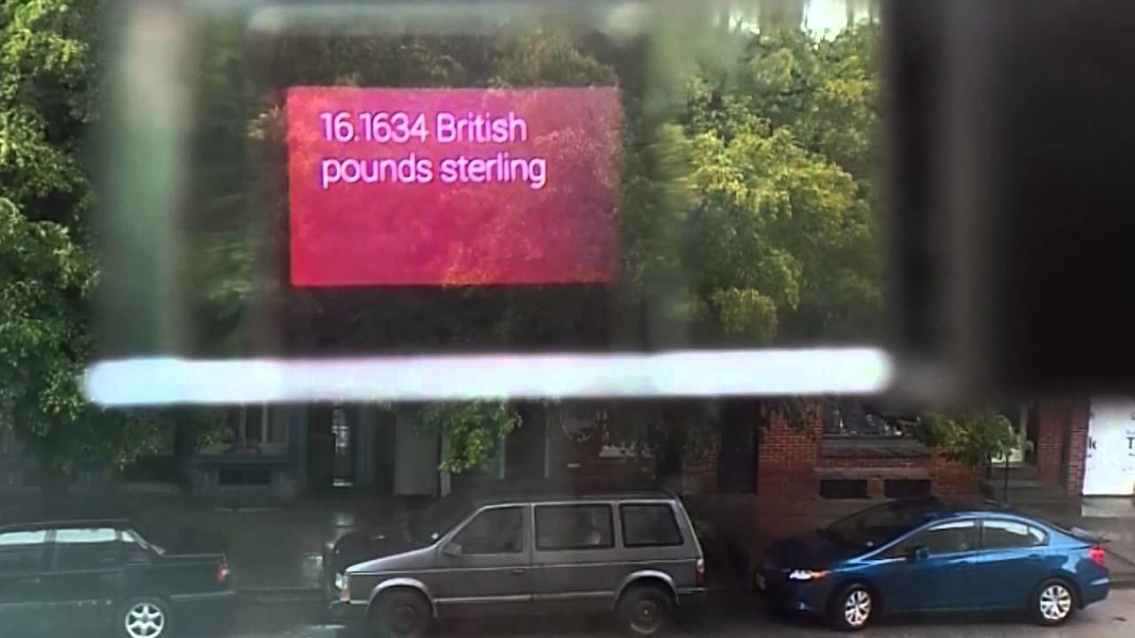

view through Google glasses

Slide 20
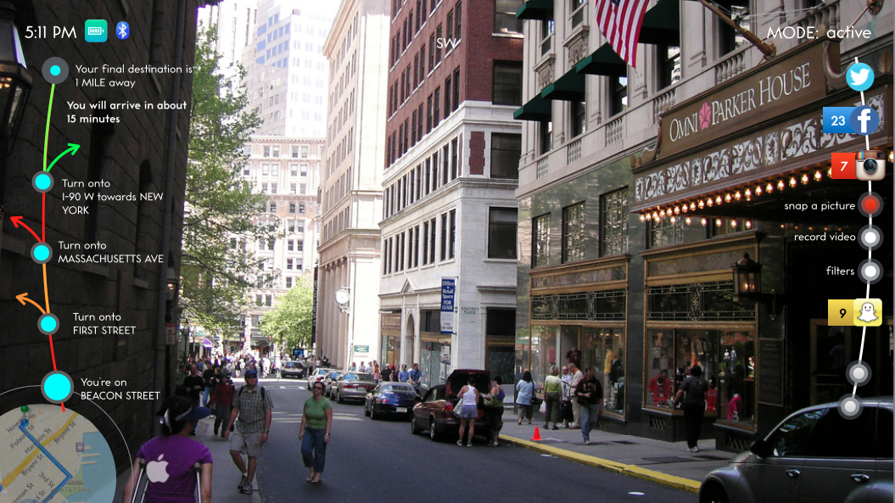
view through ICIS GLASS

Slide 21
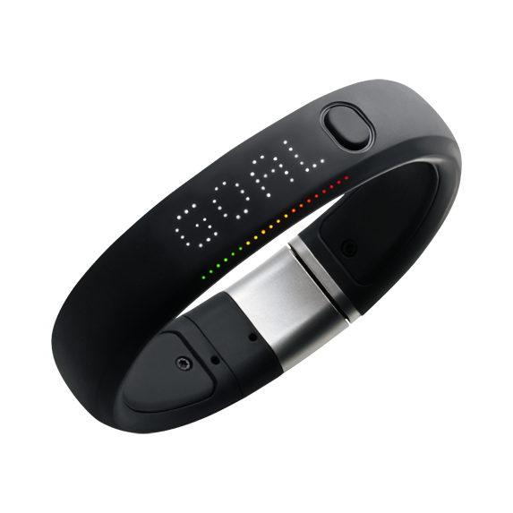
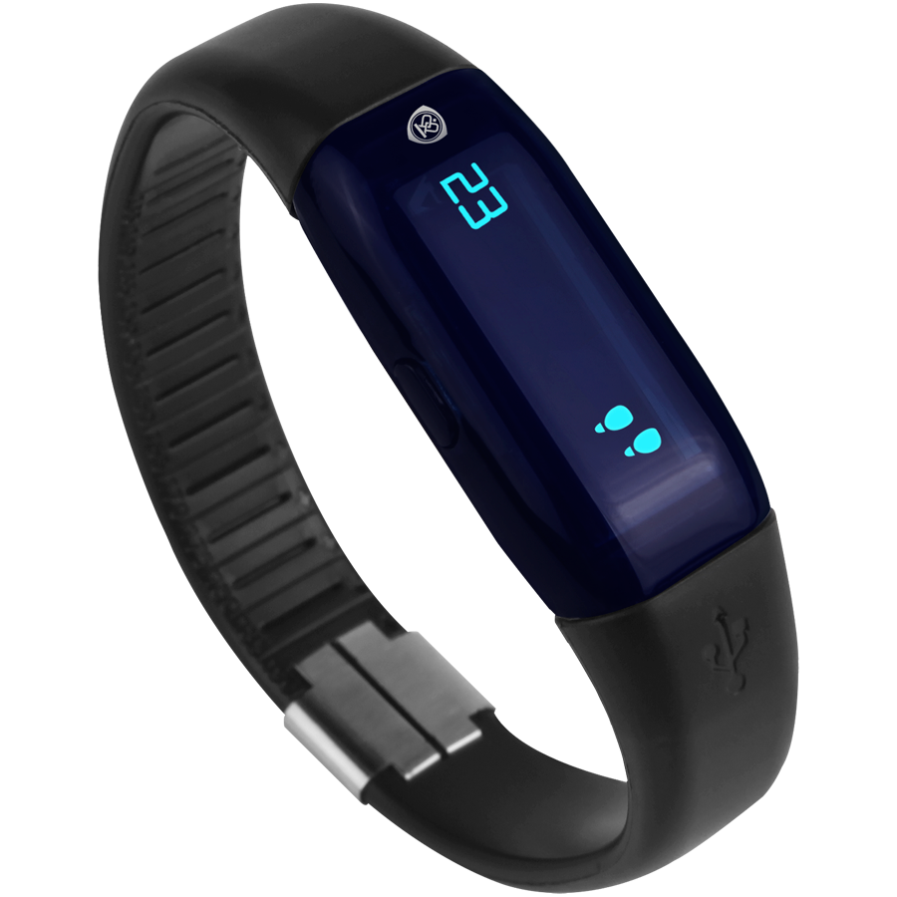
Smart bands (health bracelets, pedometers, Etc.)

Slide 22
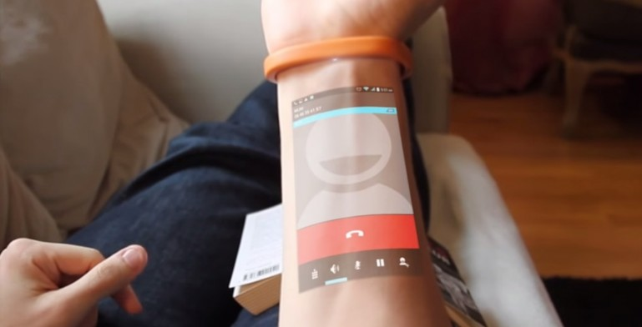
Bracelets or wristbands
a multifunctional wristband aimed at use for young people at the weekend.

Slide 23
what can it do?
identification;
pay with the wristband;
location tracking;
clock and alarm;
sponsoring big event and parties;
wireless connectivity;
detecting our heart beat rate;
physical activity and fitness monitoring.

Slide 24
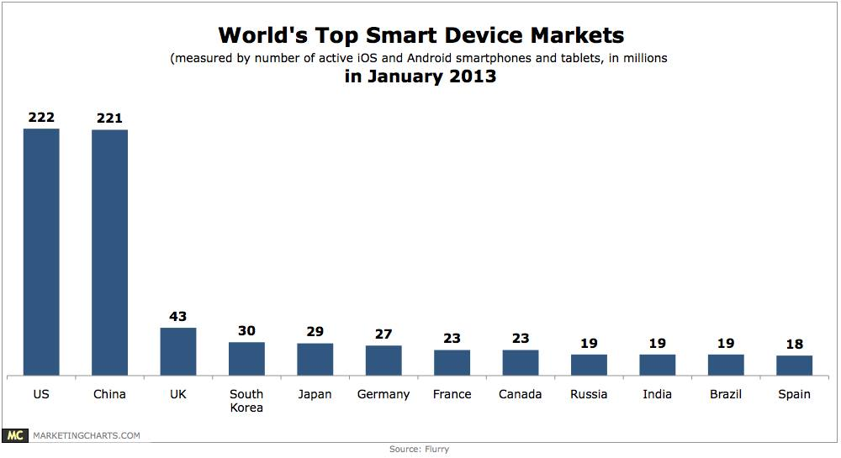

Slide 25
Advantages of smart devices
Communication Options
Web Everywhere
Device Merger
Endless Applications

Slide 26
disadvantages of smart devices
Higher cost
Security
Typing
Distraction

Slide 27
Characteristics of service access used by smart devices
General Characteristics for smart devices, environments and interaction
Internal Smart Device Properties
External System Interaction

Slide 28
General Characteristics for smart devices, environments and interaction
Feature | Requirement | Design
Multiple applications accessed via a range of devices | Devices execute multiple local processes; and act as portals to access preconfigured sets of multiple remote services | Support different mixes of local versus remote processing
Simple service access | Services should be simple to initiate and to operate | Modularisation and abstraction of ICT resources
Minimum configuration and maintenance | Device access to local resources and remote services. | Self discovery networks, services, etc. Use of appliance, utility self management, etc models
Shared resources & services | Support access to resources by multiple users | Concurrency control

Slide 29
Internal Smart Device Properties
Feature | Requirement | Design
Open, Interoperable, Heterogeneous | Users prefer a choice of service instances, access devices and networks | Use virtualisation and mediation combined with abstraction to support these properties
Dynamic service provision | Discover, select, compose & invoke services anywhere, anytime from anywhere relevant | Discover, compose, invoke & maintain services
Mobility | Range of mobile services and users depending on the application | Mobility support to: route to mobile receivers; to discover mobile access nodes
Volatile remote service access | Intermittent access is due to network failures, dynamic service access, concurrency, upgrading, etc. | Design to execute self sufficiently and in an intermittent offline mode
Local resource constraints | Some types of mobile & embedded access devices have energy, data storage, display and input constraints | Adapt operation to limited ICT resource context, limited local energy self sufficiency

Slide 30
External System Interaction
Feature | Requirement | Design
ICT Context aware | Awareness of local resource availability, Volatile remote resource availability | OS versus application support
User context aware (Personalized) | Smart devices are often personalized but users may interact with many other impersonal services. User Context is dynamic varies with activity, time, etc. | Devices act as a source for a personal space that can expand into other devices. Support for dynamic direct, indirect user profiling
Physical Context aware | Devices are active, situated in a relatively passive physical world environment | Limited awareness of the physical world

Slide 31
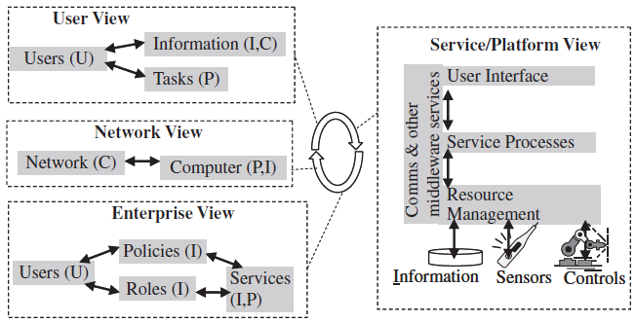
Different viewpoints of distributed ICT system components
Components are User Access (U), Service Processing (P), Communication (C), and Resources (R) such as Information (I), sensors, controllers, and other device hardware.
The User Interface (UI) is also called the presentation layer in business information models.
Processing or Computation is referred to as Application Logic or Business Logic layer in business information models.
Resources, data sources, data storage, sensors, controllers, etc. are encapsulated in the Resource Management layer in business information models.
Resources are bound to hardware, are passive, and are activated by users and services.

Slide 32
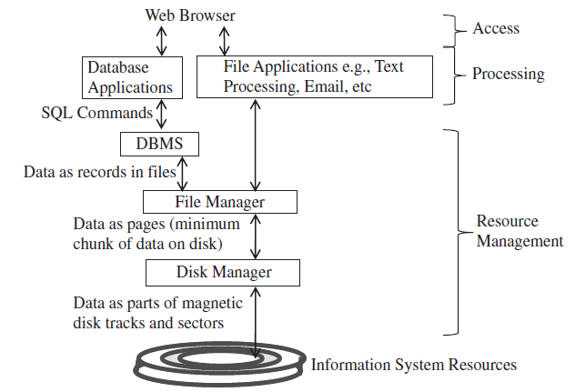
Reducing System Complexity using Abstraction (Modularisation)
System architectures focus on the idea of reducing complexity through both a separation of concerns using modularisation & transparency
Two common criteria for modules:
high cohesion
loose-coupling
Meyer (1998) uses five criteria for modularisation:
Decomposability:
Composability:
Understandability:
Continuity:
Protection:
Abstractions define those things that are important in a system
Abstraction that simplifies the view or access to internal functionality to the outside, is also called an interface.

Slide 33
Decomposability: This criterion refers to the extent to which a system can be broken down into smaller, manageable modules or components. A highly decomposable system allows for easier understanding and modification since changes can be isolated to specific modules without affecting the entire system.
Composability: Composability evaluates how effectively modules can be combined or composed to create larger systems or assemblies. Modular systems with good composability enable the integration of modules in various configurations to fulfill different requirements or accommodate changes.
Understandability: Understandability measures the clarity and ease with which a module's functionality, interfaces, and interactions can be comprehended by developers or users. Modules that are well-structured and documented facilitate understanding, leading to more efficient development, debugging, and maintenance processes.
Continuity: Continuity refers to the cohesion and coherence within modules and across module boundaries. A system with good continuity maintains logical relationships and dependencies among modules while minimizing coupling, ensuring that changes to one module do not cause unexpected side effects in others.
Protection: Protection assesses the degree to which modules can encapsulate their internal implementation details and protect them from unauthorized access or unintended interference. Module interfaces should provide controlled access to functionality while hiding implementation complexities, promoting modularity and security.

Slide 34
Service Architecture Models
Partitioning and Distribution of Service Components
Multi-tier Client Service Models
Middleware
Service Oriented Computing (SOC)
Grid Computing
Peer-to-Peer Systems

Slide 35
Partitioning and Distribution of Service Components
the key points for various designs for dividing and distributing services in ubiquitous computing environments:
Application Dependency: The design of service distribution depends on the specific application requirements. For example, a chess application may run locally on high-resource devices but may require remote execution on low-resource devices.
Communication Service Type: Different types of communication services, such as high-performance networks or unreliable mobile networks, influence the design choices for service distribution. The need to cope with network reliability and performance impacts the distribution strategy.
Access Device Type: The type of access device used, whether high-resource or low-resource, determines whether the application can execute locally or requires remote execution over the network.
Balance of Local and Remote Processing: There's a need to balance the degree of local processing and remote processing based on factors such as network reliability, available resources, and power consumption. This balance may shift dynamically based on the application requirements and available infrastructure.
Middleware Service Model: Generic services such as communication and data management can be factored out of specific application servers and hosted in computer nodes, enabling them to be shared across multiple application services.
Service-Oriented Computing (SOC): SOC defines an explicit notion of services, often implemented using technologies like XML Web Services (WS). It emphasizes modular and loosely coupled service components.
Mobile Client Model: In the mobile client model, the network addresses of client devices can move during a service invocation session, and service access is optimized for low-resource mobile devices.
Peer-to-Peer Service Model: This model supports flexible service availability over dynamic service infrastructures like mobile ad hoc networks (MANETs) and enables decentralized communication and collaboration.

Slide 36
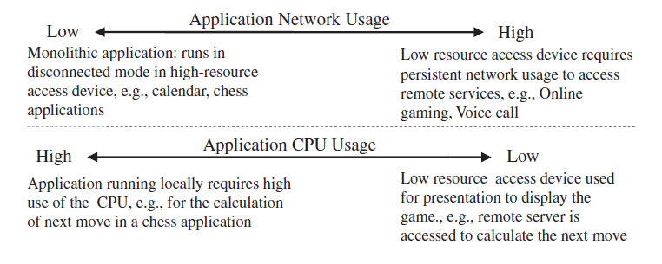
Balancing the use of local processing against the amount of communication needed depends upon the application and how it is designed.

Slide 37
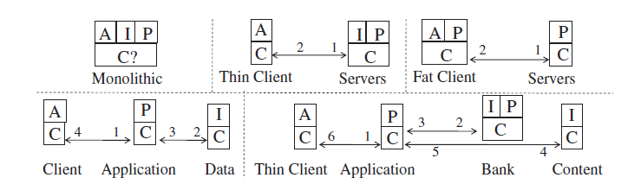
Multi-tier Client Service Models
In Figure, five different designs for information resource Ubiquitous Computing (UbiCom) systems are illustrated based on the distribution of their A (Application), P (Presentation), and I (Information) components:
Single Tier, Monolithic System
Two Tier, Thin Client-Server Model
Two Tier, Fat Client-Server Model
Three-Tier Systems
Four-Tier Systems
Five or More Tier Systems

Slide 38
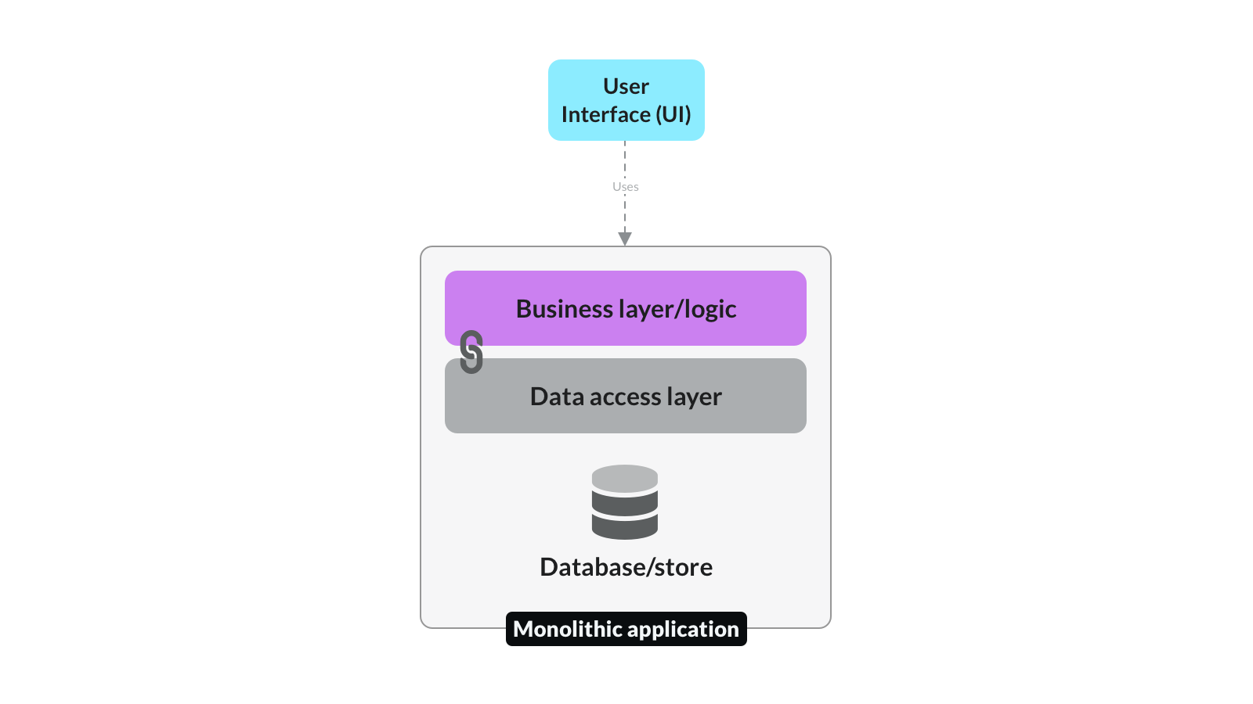
Single Tier, Monolithic System
In this design, the entire application service resides locally on a single device or tier when it is operating.
The system may have networking capabilities to go online under special conditions, such as interruptions in operation or local failures.

Slide 39
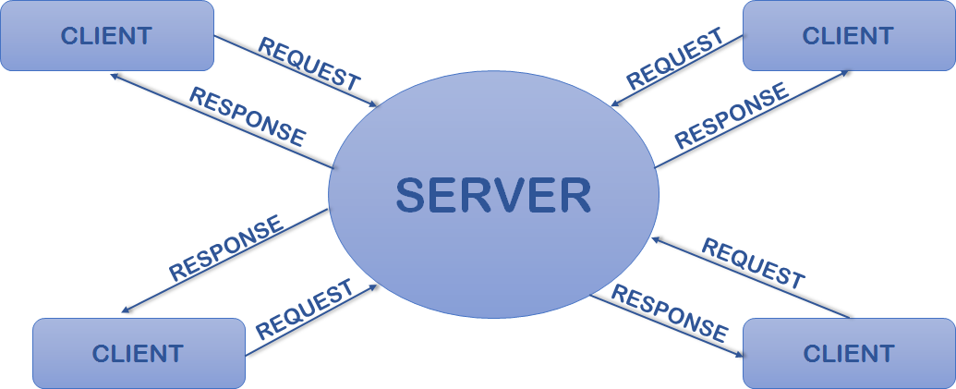
Two Tier, Thin Client-Server Model
In this model, the access device (client device or terminal) primarily supports data access or presentation.
Service processes execute remotely, and the information associated with these services is stored remotely as well.

Slide 40
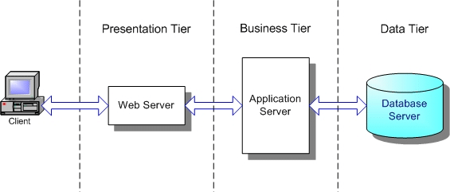
Two Tier, Fat Client-Server Model
In contrast to the thin client-server model, the access device in the fat client-server model can support some local processing and use of services.
While the device can execute some tasks locally, it can also invoke remote services as needed.

Slide 41
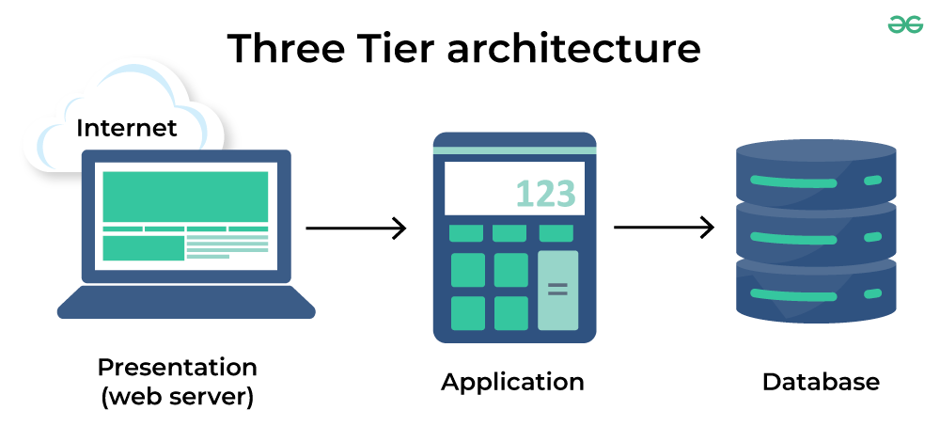
Three-Tier Systems
In a three-tier system, intermediate nodes are introduced between the access devices and the end service nodes.
Example is services that act on behalf of the access node to simplify operations. These intermediary services handle complex operations, such as authentication or data transformation, on behalf of the access device.

Slide 42
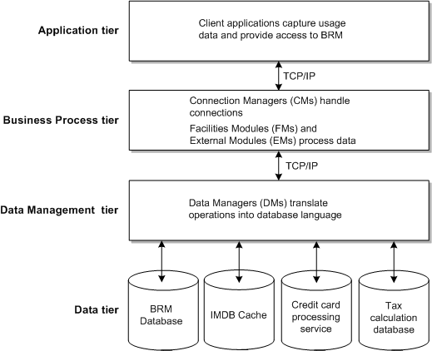
Four-Tier Systems
In a four-tier system, application processing and application data are typically put on separate nodes.
Multiple application and generic application support services, known as middleware services, can be defined to handle various aspects of application logic and data management.
For example, in an e-commerce application, a user request for a service may involve authentication and banking services, which are separate from the main application logic. These services interact with the application to verify user credentials and process payments.

Slide 43
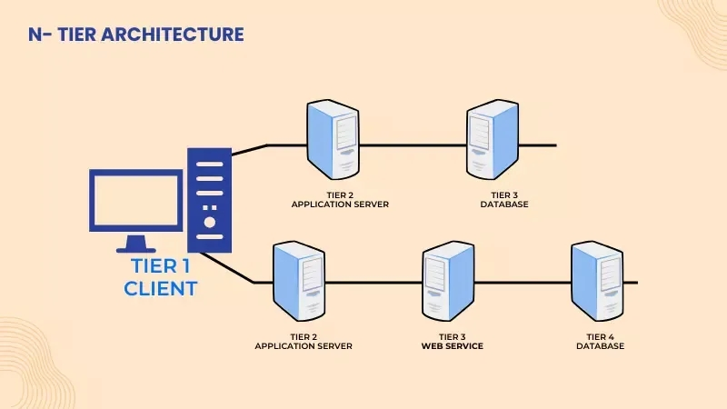
Five or More Tier Systems
Application services can also be designed to be distributed over five or more tiers depending on the complexity and requirements of the application.
For instance, in a banking application, authentication and banking services could be separated into distinct tiers to manage security and transaction processing separately.

Slide 44
Distributed Data (D) Storage
Information (I), Processing (P), Service Access (A) and Data (D) can themselves be partitioned and distributed.
Examples of Partitioned & Distributed Data
Transaction Monitors (TM): distributed data transactions;
Data Warehouses, centralized analysis of distributed data
Distributed Databases: distributed queries

Slide 45
Distributed Data (D) Storage: Transaction Processing

Slide 46
Distributed Data (D) Storage: Data Warehouse

Slide 47
Distributed Data (D) Storage: Distributed Database

Slide 48
Distributed Processing
Partitioning & distributing processing onto multiple CPUs
Use for computation-intensive tasks
Time gained in increasing processing time must be greater than time to partition & distribute tasks, collect individual results & combine them.
Many different architectures
Super-computers - specialised multiple CPU systems
Clusters of networked MTOS computers, e.g., Grids.
Multiple CPUs in MTOS computers. e.g., multi-core processor
P2P computing
Cellular computing

Slide 49
Proxy based Service Access
Some applications, to mask the complexity of communication from being supported in the client access process, use a client proxy.
Proxy-based service access can:
offload presentation processing and network processing from the low-resource client access device to the third proxy node
hide the heterogeneity of different terminal types and different types of networks
simplify and compose access to multiple service providers
reduce the complexity of communication used in access devices
enable devices to operate intermittently in a disconnected state
shield network-based applications from the mobility of the access devices

Slide 50
Proxy based Service Access
Use of proxies to simplify network access by transparently encoding and decoding the transmitted data on behalf of clients and/ or servers

Slide 51
Proxy based Service Access
What are the disadvantages of Proxy-based access?
being a single point of failure, the use of additional network hop can increase the latency
In some cases, proxy clients can be positioned far from the application Web servers and access devices, further increasing the latency.
Some of these issues can be addressed by having replicated distributed proxy servers, positioned at optimum points in the network.

Slide 52
Middleware
Middleware in ubiquitous computing refers to software that sits between the application layer and the operating system, providing services and support functions to facilitate communication, integration, and management of distributed components in a heterogeneous environment.
Key Features and Functions:
Abstraction and Heterogeneity Management
Interoperability
Communication Support
Resource Discovery and Management
Security and Privacy
Scalability and Fault Tolerance

Slide 53
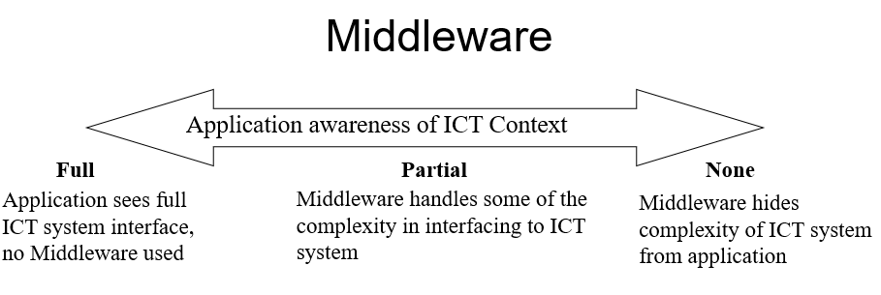
Middleware

Slide 54
Middleware
Advantages for Application?
can be application and operating system independent
Advantages for OS?
The OS does not need to be rebuilt or rebooted every time new types of hardware are added.
The middleware itself is distributed but this is transparent to the application.
The middleware model also makes applications simpler to define because the middleware can handle the complexity of dealing with the detailed use of system services.

Slide 55
Service Oriented Computing (SOC)
SOA (Architectures) , also referred to as SOC (Computing)
Services as computational or information processing components
That are autonomous and heterogeneous
Can run on different platforms
Are possibly owned by different organizations.

Slide 56
SOC Standards
Several different standards for SOC
(XML based) Web Services
Computer Grids OGSI (Open Grid Services Infrastructure )
OASIS (Organization for the Advancement of Structured Information Standards) SOA RM
Open Group SOA Working Group
Semantic Web Services

Slide 57
Service Oriented Computing (SOC)
Notion of service characterised by:
Descriptions (or specification) of some task (a set of one or more actions) that are offered by providers to users. It is assumed that descriptions are discoverable. A complication is that the provider and user may not share a common understanding of the specification or how to specify a service.
Outcomes: the service is the means to achieve a defined outcome for a task, e.g., a repair service enables normal operation to be resumed within a certain time frame.
Offers: (or tenders) to perform a task on behalf of another. It is assumed that if an offer is made that the provider is available.
Competency: to undertake the task, e.g., a provider may publicize qualifications that have been validated by an independent regulatory authority
Execution: actually, performing the service on behalf of someone.
Composition: Multiple services may need to be composed before they can be executed with respect to an outcome and time constraints.
Constraints or policies: for a service, which may be specified either by the user, e.g., for a taxi service ‘don’t drive too fast’, or by the provider ‘not exceeding the speed limit’.

Slide 58
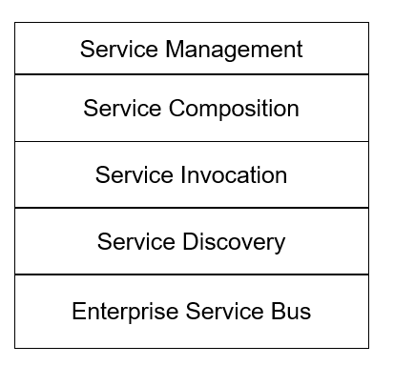
Service Oriented Computing (SOC)

Slide 59
Grids
Grid computing is a distributed computing paradigm that enables the coordinated use of heterogeneous and geographically dispersed resources to solve large-scale computational problems.
Grid computing leverages the collective power of numerous interconnected computers, storage systems, and other resources.
(Early) Grid computing system design tends to focus on high performance computing rather than fault-tolerance & dynamic ad hoc interaction.
Three main types of Grid system occur in practice:
Computational Grids: primarily emphasizes the efficient utilization of computational resources distributed across multiple nodes.
Data Grids: focuses on the management and sharing of large volumes of distributed data resources.
Service Grids: emphasizes the provision and orchestration of distributed services and resources.

Slide 60
Peer-to-Peer Systems (P2P)
P2P can be defined as:
distributed systems consisting of interconnected nodes
able to self-organize into network topologies
with the purpose of sharing resources such as content, CPU cycles, storage and bandwidth,
capable of adapting to failures and accommodating transient populations of nodes
while maintaining acceptable connectivity and performance
without requiring the intermediation or support of a global centralized servers or authorities.

Slide 61
P2P Benefits
lower cost of ownership for content sharing: by eliminating specialized server costs and by distributing the maintenance costs through multiple low-cost peers that can interact;
performance enhancements: the resources of all the nodes can be used for storage, computation and data exchange rather than focusing resources mostly in the server type nodes;
ad hoc resource utilization and sharing: as demand for particular services peaks, more nodes can act as servers, for example, as file servers, to meet demand;
autonomous control and ownership: peers can have a greater degree of and exercise more decentralized, autonomous control over their data and resources. No reliance on a central server to collect and relay information.
anonymity and privacy: session-based IDs and addresses can be assigned and can be hidden and masked as data gets routed; one cannot tell who has created data, who is querying data, who is storing data etc.;
fault tolerance: there are no central servers that can be attacked or can cause complete system failure, instead, alternative paths and servers can be used when one fails

Slide 62
P2P System Design Challenges (Limitations)
More complex coordination is often needed. In contrast, with client server interaction, clients initiate content downloads and uploads while servers react to clients to satisfy these requests or notify clients when service updates are available. In contrast, it is not so clear how to initiate sessions, e.g. two interacting peers can both decide to wait or to send to each other.
Nodes can act as freeloaders: nodes may be happy to play a role of service requesters but are always configured to refuse the requests of others to use their resources. More complex security may be needed as identification can be masked so access control is harder.
Network address discovery: peers need to be dynamically assigned network addresses and to discover addresses of destination nodes. The use of broadcasting to discover the network addresses of others can flood networks.
Ad hoc network routes: need to create and discover ad hoc routes between nodes, inefficient multi hop routes can form to link source nodes to destination nodes.
Service discovery: how to discover the selective nodes where services can be invoked from versus the inefficiency of distributing services to all nodes.

Slide 63
Variations of P2P system
3 main types of P2P system depending on the types of computer nodes:
Pure P2P
Partial P2P
Hybrid P2P networks

Slide 64
Pure peer-to-peer (P2P) refers to a decentralized networking architecture where every participant in the network can act as both a client and a server. In a pure P2P system, there is no central server or authority controlling the network; instead, all nodes communicate directly with each other, forming a distributed network where resources and responsibilities are shared among participants.
Partial P2P, also known as hybrid P2P, refers to a networking architecture that combines elements of both peer-to-peer (P2P) and client-server models. Unlike pure P2P systems where all participants have equal roles and responsibilities, partial P2P systems incorporate centralized components or servers alongside peer-to-peer interactions.
Hybrid P2P, also known as hybrid peer-to-peer, is a networking architecture that combines elements of both peer-to-peer (P2P) and client-server models in a more integrated and sophisticated manner than partial P2P systems. In hybrid P2P architectures, nodes in the network can act as both clients and servers, and the system dynamically adapts its behavior based on factors like network conditions, resource availability, and user preferences.

Slide 65
P2P System Types: Pure, Hybrid

Slide 66
P2P System Types : Partial P2P

Slide 67
Service Provision Life Cycle
Service Provision Life-Cycle in ubiquitous computing is divided into four phases namely
Service creation,
Service operation,
Service maintenance and
Service dissolution.
The provision of application services for smart devices entails the management of distributed services throughout their life cycle and not just in specific phases such as service discovery.
There are two separate aspects to this, first, defining a generic life cycle model for service provision and, second, to manage this life cycle.
In a simple service provision lifecycle model, only two of the five service model components are active, the processing services or service provision and service access or clients, the other three components, communication, stored information and information sources, are treated as passive components.

Slide 69
Service creation:
Service processes registers themselves in service directory
Service requesters in access nodes search for services.
Services get selected, configured and multiple services need to be composed.
Service execution:
Services are invoked and multiple interlinked services need to be coordinated.
69
Notes:
69

Slide 70
Service maintenance:
Service processes, access configurations, service compositions can be updated
Service Dissolution:
Services may be put off-line or terminated temporarily by the processes themselves or by requestors
70
Notes:
70

Slide 71
Static device like: set-top audio video receivers can support both dynamic service initiation and execution.
This enables the device to be preconfigured using default settings and shipped to be used in different regions where it must detect and tune itself to regional RF broadcast signal sources.
This can also enable a static smart device to switch to an alternative service provider when a fault occurs, providing the user has permission to access, possibly via another service contract.to

Slide 72
Network Discovery must precede service registration and service discovery.
Dynamic network discovery is used by mobile nodes and when new nodes are introduced into a network.
DNS is used to map IP address to a name of some network node and vice versa.
DHCP is used to discover network: A DHCP server manages a record of all the IP addresses it allocates to network nodes.
Complexity is managing DHCP server and in detecting & resolving duplicate IP addresses because multiple DHCP servers may issue overlapping addresses.
Permanent may conflict with dynamic.
Zeroconf or zeroconfiguration networking : set of techniques that automatically creates usable IP network without configuration or special servers.
72
Notes:
72

Slide 73
Service announcements, service Discovery
If service providers or requesters are static
Then need arises for dynamic service discovery
Is needed to allow service requesters to change providers when requesters or providers are mobile.
When network access is intermittent and when they( R & P) fail.
Dynamic service discovery: involves decoupling service provision from service requests and supporting dynamic announcements.
73
Notes:
73

Slide 74
Service announcements, service Discovery contd..
2 approaches of service announcemnets
Push: uses broadcast to announce available service requests or capabilities to no of unknown parties.
Pull: uses lookups to search or browse requests or capabilities previously announced to the directory held by some known third party.
74
Notes:
74

Slide 75

Web Services (WS) support machine-to-machine interaction
Service Interfaces described in machine-processable, syntactical format
WS SOAs consist of many possible WS protocols depending on the application and service requirements.
Core WS SOA protocols are:
SOAP: Used as a lightweight XML-based transport-independent protocol to exchange information between peers in a distributed environment.
WSDL: Web Service definition language, used to define sequences of service actions.
UDDI : Universal Description, Discovery, and Integration: is directory based infrastructure, XML based standard for describing, publishing and finding web services
75
Notes:
75
75

Slide 76
Service Invocation
Specifying an application protocol in terms of a set of service descriptions of service actions is often insufficient to invoke a service.
Requesters need to know how to invoke the services
It may require to download specific service access software.
Requesters may not know order of execution
Interaction in the process needs to be coordinated.
Often coordination may be hard-coded into each service API and under the control of the provider.
Makes the coordination of multiple services inflexible.
76
Notes:
76
76

Slide 77
Service Invocation
Multiple heterogeneous processes need to be interleaved
Eg: select item, order item, receive acknowledgement and receive item need to be interleaved with separate pay for item process.
Different approaches to service invocation
Depending on application interaction pattern
Characteristics of service infrastructure
Main service invocation designs considered include:
Volatile service access
On- demand service request
Delayed reads & mail boxes
Event based notification etc..
77
Notes:
77
77

Slide 78

Enterprise Service Bus or ESB supports messaging, Web Service integration, data transformation and intelligent routing for SOC
Decouples service provision from service access.
78
Notes:
78
78

Slide 79

Service processes are sequences of individual service actions that are scheduled for execution.
Service processes may involve one or more entities, one or more actions and involve one or more processes.
Composition concerns?
Statically organising services design issues.
Dynamic service composition?
Composition can occur incrementally
79
Notes:
79
79

Slide 80
Smart Mobile Devices
Smart mobile devices encompass a broad category of portable electronic gadgets designed to provide various functionalities beyond traditional calling and texting.
They are characterized by their advanced computing capabilities, connectivity options, and versatile features.
Here are some common types of smart mobile devices: Smartphones, Tablets, wearable Devices, Smart Home Devices, Gaming Consoles, E-readers.

Slide 81
Characteristics of Smart Mobile Devices
Connectivity: Smart mobile devices are equipped with various connectivity options, including Wi-Fi, Bluetooth, cellular data, and NFC (Near Field Communication), enabling users to connect to the internet, other devices, and networks.
Operating System (OS): Smart mobile devices run on sophisticated operating systems like iOS (Apple), Android (Google), or Windows Mobile, which provide a platform for running applications and managing device functionality.
Touchscreen Interface: Most smart mobile devices feature touchscreen displays, allowing users to interact with the device through gestures such as tapping, swiping, and pinching.
Multimedia Capabilities: Smart mobile devices support multimedia features like high-resolution displays, cameras for photos and videos, audio playback, and sometimes even video editing capabilities.
Application Ecosystem: They have access to extensive app ecosystems through dedicated app stores (e.g., Apple App Store, Google Play Store) where users can download and install various applications for productivity, entertainment, communication, and more.
Processing Power: Smart mobile devices are equipped with powerful processors (CPUs and GPUs) and sufficient RAM to handle multitasking, run demanding applications, and provide a smooth user experience.

Slide 82
Characteristics of Smart Mobile Devices
Sensors: They incorporate a variety of sensors such as accelerometers, gyroscopes, GPS, ambient light sensors, proximity sensors, and fingerprint scanners, which enable features like motion sensing, location-based services, automatic screen brightness adjustment, and security enhancements.
Portability: Smart mobile devices are designed to be portable and lightweight, allowing users to carry them easily and use them on the go.
Customization Options: Users can personalize their smart mobile devices with custom wallpapers, themes, widgets, and settings to suit their preferences and needs.
Battery Life Management: Smart mobile devices employ power management techniques to optimize battery life, including battery-saving modes, adaptive brightness, and background app management.
Security Features: They offer various security features such as device encryption, biometric authentication (e.g., fingerprint scanning, facial recognition), remote device tracking and wiping, and secure app sandboxes to protect user data and privacy.
Cloud Integration: Many smart mobile devices seamlessly integrate with cloud services, enabling users to store and access their data (e.g., photos, documents, contacts) across multiple devices and platforms.

Slide 83
Mobile service design
Mobile service design in ubiquitous computing focuses on creating seamless and context-aware experiences for users across various devices and environments.
Ubiquitous computing, also known as pervasive computing, involves integrating computing technology into everyday objects and environments to make them smarter and more responsive to user needs.

Slide 84
Key considerations and principles for mobile service design in ubiquitous computing
Context Awareness: Design mobile services that are aware of the user's context, including location, time, preferences, and activities. Utilize sensors and data from the environment to adapt the service experience accordingly.
Seamless Experience: Aim for a seamless and consistent user experience across different devices and interaction channels. Users should be able to transition between devices and contexts without interruptions or disruptions.
Adaptive Interfaces: Design interfaces that can adapt to different screen sizes, input methods, and environmental conditions. Consider responsive design principles to ensure that the service remains usable and accessible across a variety of devices and platforms.
Personalization and Customization: Provide options for personalization and customization to tailor the service experience to individual user preferences and needs. Allow users to configure settings, adjust preferences, and receive personalized recommendations.
Contextual Interaction: Enable contextual interaction by leveraging contextual cues and user input to anticipate user needs and provide relevant information or services proactively. For example, a smart assistant could suggest nearby restaurants based on the user's location and past dining preferences.

Slide 85
Key considerations and principles for mobile service design in ubiquitous computing
Privacy and Security: Prioritize user privacy and security by implementing robust data protection measures and obtaining user consent for data collection and processing. Minimize the collection of sensitive information and ensure transparent communication about how data is used.
Cross-Device Integration: Enable seamless integration and synchronization between different devices and platforms to provide a cohesive user experience. Allow users to access and interact with the service from smartphones, tablets, wearables, smart home devices, and other connected devices.
Feedback and Iteration: Collect feedback from users and iterate on the design based on user insights and observations. Conduct usability testing and gather user feedback to identify pain points, usability issues, and areas for improvement.
Scalability and Reliability: Design mobile services that are scalable and reliable to accommodate varying usage patterns and handle fluctuations in demand. Ensure that the service can scale gracefully to support increasing numbers of users and devices.
Accessibility: Ensure that the mobile service is accessible to users with diverse abilities and needs. Consider accessibility guidelines and standards to make the service usable for individuals with disabilities, including visual impairments, motor impairments, and cognitive impairments.

Slide 86
SMS (Short Message Service)
SMS is a ubiquitous communication channel that allows users to send and receive short text messages via mobile devices.
In mobile service design, SMS can be utilized for quick notifications, alerts, reminders, and transactional communication between users and service providers.
It serves as a reliable and accessible means of communication, particularly in areas with limited internet connectivity.

Slide 87
Mobile Web Services
Mobile web services refer to online platforms and applications accessible through mobile web browsers.
They provide users with access to information, resources, and interactive functionalities directly from their mobile devices.
In ubiquitous computing, mobile web services play a crucial role in delivering content, services, and experiences across different devices and environments.
They are designed to be responsive, adaptable to various screen sizes and resolutions, and often integrate with native device features to enhance functionality and user engagement.

Slide 88
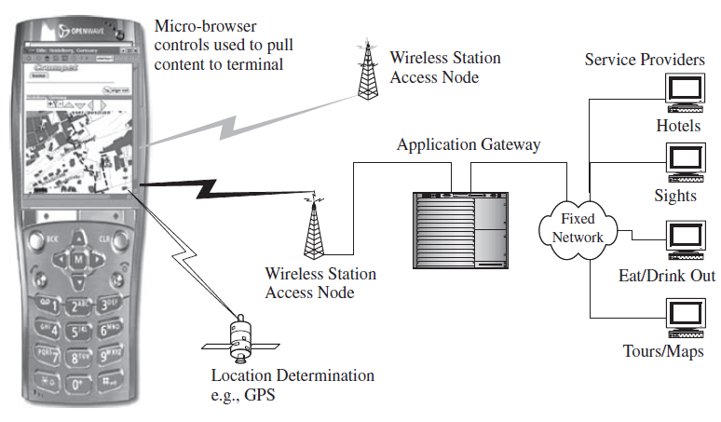
Thin client server architecture example
A micro-browser running on a mobile device is used to retrieve content over a wireless network.

Slide 89
Java VM (Java Virtual Machine) in Mobile Service Design
Java VM is a virtual machine that enables the execution of Java bytecode, allowing Java applications to run on various platforms without modification.
In mobile design, Java VM provides a platform-independent environment for developing and deploying mobile applications.
It allows developers to write applications in Java programming language and run them on different mobile devices that support Java ME (Micro Edition) or other Java-based mobile platforms.

Slide 90
J2ME in Mobile Service Design
J2ME (Java 2 Platform, Micro Edition) is a version of the Java platform designed for resource-constrained devices, such as mobile phones, PDAs, and embedded systems.
It provides a set of libraries, APIs, and virtual machine specifications tailored for mobile and embedded development.
J2ME is commonly used in mobile design to create lightweight, portable applications for feature phones and early smartphones.
It offers APIs for user interface development, network communication, database access, and other mobile-specific functionalities.

Slide 91
.Net CF in Mobile Service Design
.NET CF (Compact Framework) is a subset of the Microsoft .NET Framework designed for building applications for resource-constrained devices, including Windows Mobile and Windows Embedded Compact devices.
In mobile design, .NET CF enables developers to write applications in languages like C# and VB.NET and run them on Windows Mobile devices.
It provides access to a subset of the .NET Framework APIs optimized for mobile development, including UI controls, data access, networking, and security features.

Slide 92
Mobile Code
Mobile code refers to executable code that is transmitted and executed on a mobile device, typically over a network.
Mobile code allows the execution of code on a mobile device that is not pre-installed but is transmitted from a remote server or another source. This enables dynamic updates, feature enhancements, and bug fixes without requiring users to manually update their applications.
Mobile code often involves the use of web-based technologies such as JavaScript, HTML, and CSS. This allows developers to create responsive and interactive mobile web applications that can be accessed through mobile browsers.
Mobile code enables the delivery of dynamic content to mobile applications. This can include personalized content, real-time updates, and interactive elements that enhance the user experience.

Slide 93
Smart Card Devices
A smart card is a plastic card embedded with digital memory and (usually) a microprocessor chip, as opposed to cards that store data on magnetic strips. It is reprogrammable, stores and processes data in the card, and transacts data between card users and applications.
Data can be stored and processed within the card’s memory or microprocessor, which is accessed using a card reader.
Smart cards are small and easy to carry around.
They provide a secure data container, that can be used for authentication purposes, e.g., as a hardware-based digital signature, and can be used for metered services.

Slide 94
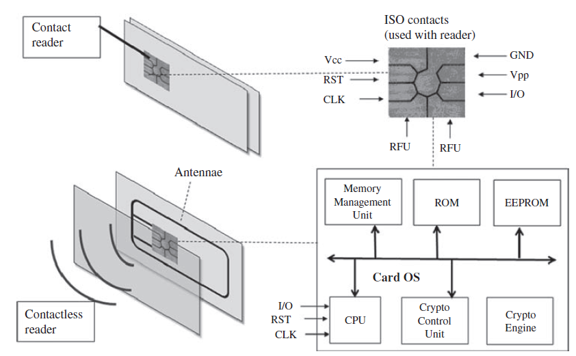
Contactless and Contact Smart Cards
Smart cards maybe either contact-based or contactless.
Contact cards have to be inserted in a reader and a physical electrical contact made.
This may be chosen for security reasons, e.g., a chip (and enter) PIN (Personal Identification Number) application.
Contactless cards also contain an antenna and an RF transceiver or transponder.
The card can be waved near a reader or base station to interact, e.g., a smart travel card designed to be contactless reduces the time to gain authorization compared to the use of a contact card.
Contactless cards include an inbuilt antenna and transceiver to interact with a reader. Contact cards include electrical contacts for a reader.
A typical smart card OS is also shown.

Slide 95
Smart Card OS
The primary tasks of a smart card operating system
transferring data to and from the smart card,
controlling the execution of commands,
managing files,
managing and executing cryptographic algorithms to protect access to stored data, and
managing and executing program code.
The components of a typical card OS are combined into a single IC chip to reduce size.
To standardize the communication protocol between the on-card application, and off-card programs accessed via the reader, the ISO/IEC 7816 standard has been defined.

Slide 96
Smart Card Development
Java Card refers to the technology that allows small Java-based applications (applets) to be run securely on smart cards and similar small memory footprint devices such as JavaRings.
A Java Card is the tiniest version of Java targeted for embedded devices. It is widely used in SIM cards (used in GSM mobile phones) and ATM cards.
Java CardVM runs in many smart cards, e.g., the GSM phone Subscriber Identification Module (SIM) card. SIM cards securely store the service subscriber key (IMSI) that is used to identify a subscriber.
SIM cards allow users to change phones by simply removing the SIM card from one mobile phone and inserting it into another mobile phone or broadband telephony device.
Java Card focuses on providing a common programming interface for the development of smart card applications

Slide 97
Thank you
any questions?

